Slide 1
SHOP
Customer Segmentation Using K-Means Clustering
A Menternship Project on Online Retail Analytics

Slide 2
The Challenge
Retailers struggle to personalize marketing for diverse customer bases.
Needed a way to understand and segment customers based on real transaction data.
Mercury
Mars
Jupiter
Needed a way to understand and segment customers based on real transaction data.
Goal: Improve targeting, retention, and revenue using customer insights.

Slide 3
Approach & Tools Used
Method
A
Unsupervised learning using K-Means Clustering.
Tools
B
Python, Pandas, Matplotlib, Seaborn, Scikit-learn.
Key Features Used
C
Recency (last purchase)
Frequency (number of purchases)
Monetary Value (total spent)

Slide 4
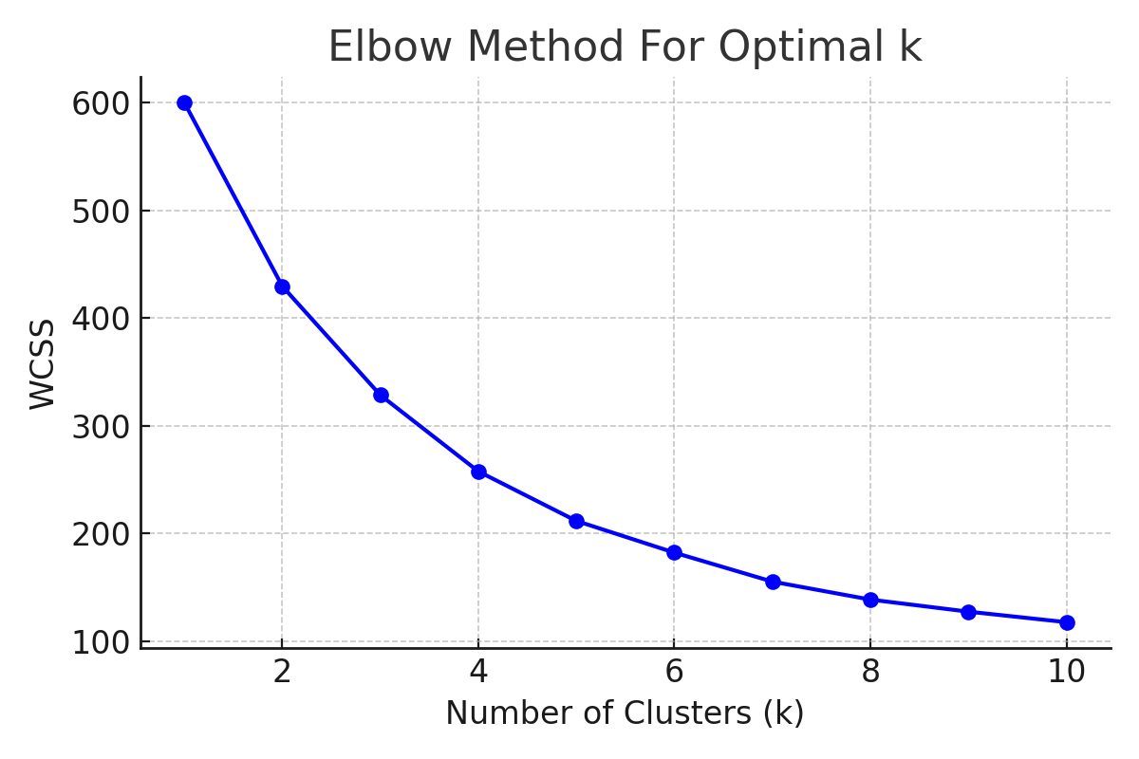
Steps Taken
80%
30%
45%
65%
92%
Data preprocessing and cleaning
$
Feature engineering: created RFM variables`
$
$
Standardized data and used Elbow method to determine optimal clusters
$
$
Applied K-Means algorithm
Visualized results using PCA plots and cluster summaries

Slide 5
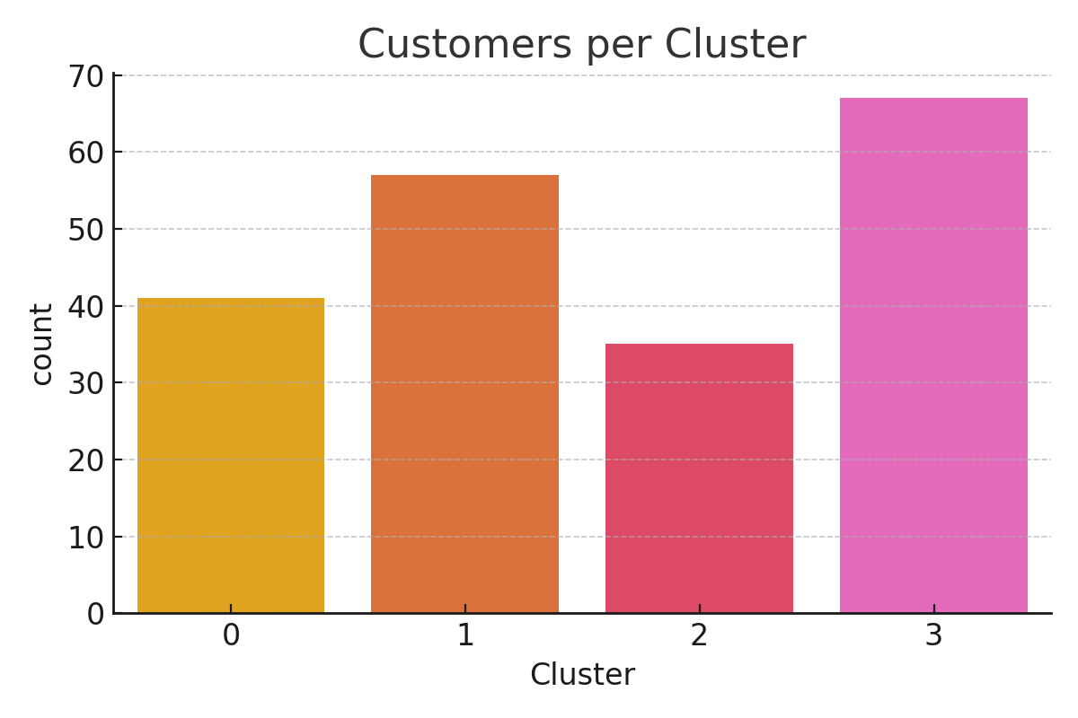
Key Findings – 4 Customer Segments
0
3
Loyal Big Spenders
Dormant Users
Frequent, recent, high-spending customers
Inactive, need re-engagement
01
04
E-COMMERCE PROCESS
1
02
03
2
Occasional Buyers
Bulk Buyers
Moderate behavior, churn risk
Price-sensitive, large quantity buyers

Slide 6
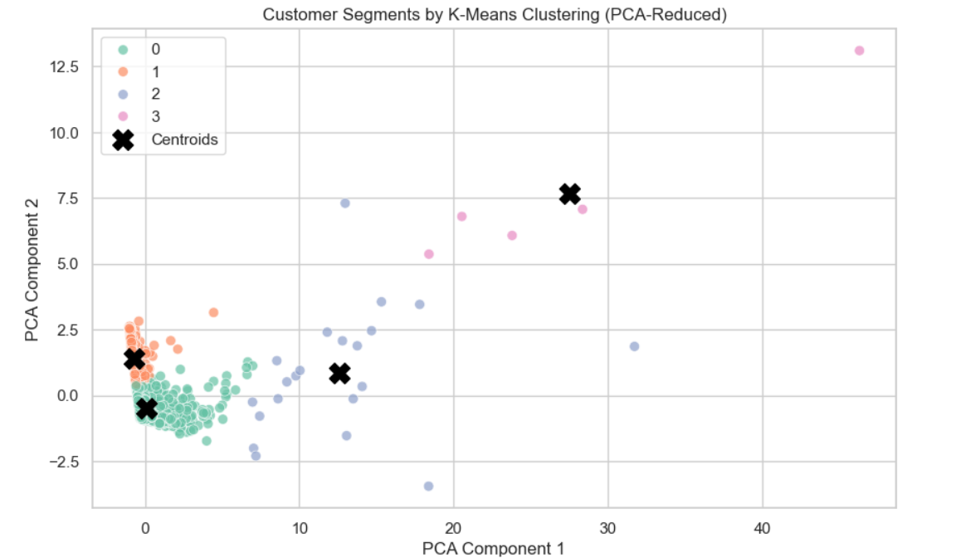
PCA Cluster Visualization
PAY
Data preprocessing and cleaning
01
Neptune is the farthest planet from the Sun and a gas giant
Mercury
02
Mercury is the closest planet to the Sun and the smallest one
Mars
03
Despite being red, Mars is a cold place full of iron oxide dust
Venus
04
Venus has a beautiful name and is the second planet

Slide 7
Business Impact
Enabled targeted strategies:
Improved potential for
VIP programs for top spenders
Win-back campaigns for dormant users
Discounts for bulk buyers
customer retention, revenue growth, and marketing ROI

Slide 8
Conclusion
Learned hands-on application of clustering to solve real-world business problems
Excited to apply these insights to future roles in data science and analytics!
Gained skills in data analysis, modeling, and insight generation

